Slide 1
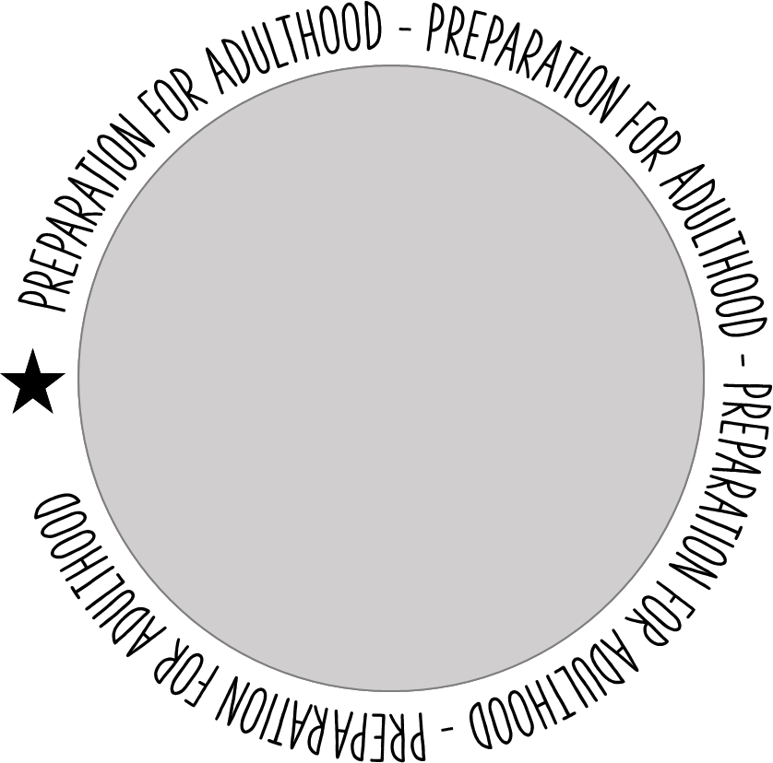



RAVENSHALL PfA
CURRICULUM PATHWAYS
TOWARDS INDEPENDENCE PATHWAY
PATHWAY OFFER
Personalised curriculum package offering learning opportunities with a strong emphasis on preparation for adulthood and independent living.
Literacy, communication and numeracy taught, used and applied in real life contexts.
Developing skills for daily living and personal independence, including shopping, cooking and home management.
Life Skills in a range of different contexts developing skills for greater independence.
Healthy Living – Making healthy choices, learning to look after your physical and mental health.
Structured sequenced learning driven by holistic targets with EHCP outcomes at its core.
Engaging, practical hands on learning activities that take place inside and outside of the classroom, including Art and Outdoor Learning
Supportive annual review process
PSHCE / RSE Topics delivered through ‘All About Me’ Schemes of Learning.
Reading for All – Daily reading, phonics and communication skills.
Extra Curricular and Residential visit opportunities.
Broad range of offsite learning opportunities, including the ‘My World’ scheme of learning making themed visits, people who help me, making the most of leisure time, Arts, Heritage and Culture etc.
DELIVERY
5 Day Provision – 9:00am – 3:00pm
5 Lessons Per Day
+ 1 Reading for All Lesson Per day
+ 1 Thrive Time Lesson Per day
Small Group Sizes
1:1 Intervention
Mental Health and Wellbeing Support and Intervention
Onsite and Offsite Learning
Specialist Staff
Vocational, Life skills curriculum
PREPARATION FOR ADULTHOOD - BRINGING LEARNING TO LIFE AND LIFE TO LEARNING

Slide 2
RAVENSHALL PfA
CURRICULUM PATHWAYS
EMPLOYABILITY PATHWAY
PATHWAY OFFER
Personalised curriculum package offering learning opportunities with a strong emphasis on preparation for adulthood and independent living.
Literacy, communication and numeracy taught, used and applied in real life contexts.
Developing skills for daily living and personal independence, including shopping, cooking and home management.
Life Skills in a range of different contexts developing skills for greater independence and personal safety.
Healthy Living – Making healthy choices, learning to look after your physical and mental health.
Structured sequenced learning driven by holistic targets with EHCP outcomes at its core.
Engaging, practical hands on learning activities that take place inside and outside of the classroom, including Performing Arts and 180 PfA Enterpise.
Supportive annual review process
PSHCE / RSE Topics delivered through,PSHCE lessons, drama, assemblies and interventions.
Reading for All – Daily reading, phonics and communication skills.
Extra Curricular and Residential visit opportunities.
Broad range of offsite learning opportunities, including the Gym, Oakwell Hall, Batley Bulldogs and Little Deerwood
DELIVERY
5 Day Provision – 9:00am – 3:00pm
5 Lessons Per Day
+ 1 Reading for All Lesson Per day
+ 1 Thrive Time Lesson Per day
Range of accredited qualifications
Small Group Sizes
1:1 and small group interventions
Mental Health and Wellbeing Support and Intervention
Enterprise
Onsite and Offsite Learning
Specialist Staff
Vocational, Life skills curriculum
Personal Finance and Personal Safety
PREPARATION FOR ADULTHOOD - BRINGING LEARNING TO LIFE AND LIFE TO LEARNING

Slide 3

RAVENSHALL PfA
CURRICULUM PATHWAYS
TOWARDS INDEPENDENCE PATHWAY
PUPIL PROFILE
RAVENSHALL Post 16 Towards Independence Pupil Profile
Ravenshall Post 16 Towards Independence Pathway caters for young people aged 16-19 with severe learning difficulties/ disabilities across all areas of their development, who are not able to access the routines and academic demands of college or our Employability Pathway.
We anticipate that after 3 years on the Towards Independence Pathway some of our cohort may be college ready and be able to access a course available to them from the local offer. Whilst others will be supported by Adult services to select a more appropriate route out of education.
Ravenshall has a team of specifically trained staff (including speech and language specialists) as many of our pupils have communication difficulties and rely on skilled staff to support them using a total communication approach which supports their language, communication and holistic development.
Learners on our Towards Independence course are likely to have:
Communication and interaction difficulties
Sensory needs
Moderate physical needs
Moderate medical needs
Severe learning difficulties across all areas of the curriculum.
The Towards Independence Pathway is a provision for:
Young people with communication difficulties who are reliant on specifically trained and skilled staff (including Speech and language therapists) to support their development using a total communication approach.
Young people who have Autism, but for whom Autism is not their Primary area of need.
Young people who may have physical and sensory needs and require individualised plans and adapted approaches.
Young people whose main areas for development are personal independence and self-help skills, including following daily routines and keeping themselves safe.
Young people who may be able to access some Employability units of work alongside their peers.
Young people who need support to understand and cope with their basic emotions to achieve greater wellbeing.
Young people who are developing confidence and functional social skills and need to learn appropriate social behaviour in a range of contexts within PFA and the community.
Young people with mild – moderate medical needs who require the support of trained staff and first aiders.
Young people who are beginning to development interests and hobbies and need a wide range of experiences to develop these.
PREPARATION FOR ADULTHOOD - BRINGING LEARNING TO LIFE AND LIFE TO LEARNING

Slide 4
RAVENSHALL PfA
CURRICULUM PATHWAYS
TOWARDS INDEPENDENCE PATHWAY
PUPIL PROFILE
Our busy varied curriculum is designed to meet the needs of those pupils who need to develop confidence and personal independence. They require support to develop self-help skills and an understanding of basic emotions, and how to recognise and control these in themselves and others.
Spending time offsite in the community is an integral part of the curriculum and an essential part of the timetable designed to meet our pupils need to develop functional social skills and appropriate social behaviour in a range of contexts, in PfA and in the community. This also supports an understanding of daily routine and crucially our pupils need to develop an understanding of how to keep themselves safe in a variety of situations.
We support all our young people’s wellbeing and ensure they are provided with opportunities to develop hobbies and interests that will continue into adulthood and their life after Ravenshall.
Pupils will be working at Pre-Entry level but will be able to access some entry level aspects of the broader curriculum where appropriate. It is hoped that some pupils will be able to participate in elements of the Employability pathway working alongside their peers.
All of our pupils have and EHCP and work towards personalised holistic targets which have been developed with this document at their core, to ensure all pupils make progress, and that this progress is relevant to them as individuals.
PREPARATION FOR ADULTHOOD - BRINGING LEARNING TO LIFE AND LIFE TO LEARNING

Slide 5

RAVENSHALL PfA
CURRICULUM PATHWAYS
EMPLOYABILITY PATHWAY
PUPIL PROFILE
RAVENSHALL EMPLOYABILITY PATHWAY
Ravenshall Post 16 Employability Pathway caters for young people aged 16-18 with learning difficulties/ disabilities across all areas of their development, who are not yet able to access the routines and academic demands of college but for who, with an additional two years in a nurturing yet challenging environment, under the guidance and support of skilled highly qualified staff, college an internship or employment are very real possibilities for their adult life.
There is a strong emphasis on the teaching and development of vocational, employability skills which equip our learners with valuable transferable skills. It is our intent that pupils, upon leaving Ravenshall, are more confident, independent Lifelong learners with ambition, opinions, personal goals and a voice, ready to embark on their journey into adulthood.
Ravenshall has a team of specifically trained staff (including speech and language specialists) as many of our pupils have communication difficulties and rely on skilled staff to support them using a total communication approach which supports their language, communication, and holistic development.
Learners on our Employability course are likely to:
Have Communication and interaction difficulties
Have Sensory needs
Have Moderate physical needs
Have Moderate medical needs
Have Moderate, complex, learning difficulties across all areas of the curriculum.
Demonstrate a vulnerability that can mean they could be easily influenced or targeted by others.
Have an EHCP
Demonstrate a potential to progress to college, training or employment
Be working at Entry Level 1 or above
Demonstrate the need for significant input and teaching in the core functional skills, reading, writing, communication and Numeracy.
PREPARATION FOR ADULTHOOD - BRINGING LEARNING TO LIFE AND LIFE TO LEARNING

Slide 6
RAVENSHALL PfA
CURRICULUM PATHWAYS
EMPLOYABILITY PATHWAY
PUPIL PROFILE
The Employability Pathway is a provision for:
Young people with communication difficulties who benefit from trained and skilled staff (including Speech and language therapists) to support their development using a total communication approach.
Young people who have Autism, but for whom Autism is not their Primary area of need.
Young people who may have physical and sensory needs and require individualised plans and adapted approaches.
Young people who need to develop personal independence and self-help skills, including keeping themselves safe, home management and social skills and risk assessment when in the community.
Young people who need to develop a deeper understanding of PSHCE and RSE topics
Young people who may be able to access ongoing education, employment, or training.
Young people who need support to understand and cope with their emotions to achieve greater wellbeing.
Young people with mild – moderate medical needs who require the support of trained staff and first aiders.
Young people who are beginning to development interests and hobbies and need a wide range of experiences to develop these.
Young people who need to develop resilience, self-confidence and develop personal goals and aspirations.
Our busy varied curriculum is designed to meet the needs of those pupils who need to develop confidence and personal independence. They require support to develop self-help skills and an understanding of emotions, and how to recognise and control these in themselves and others.
Spending time offsite in the community is an integral part of the curriculum and an essential part of the timetable designed to meet our pupils need to develop functional social skills and appropriate social behaviour in a range of contexts, in PfA and in the community. This also supports an understanding of daily routine and crucially our pupils need to develop an understanding of how to keep themselves safe and problem solve in a variety of situations.
We support all our young people’s wellbeing and ensure they are provided with opportunities to develop hobbies and interests that will continue into adulthood and their life after Ravenshall.
PfA provide high quality learning opportunities for young people with a diverse range of needs inclusive of pupils who have Autism, but for whom Autism is not their Primary area of need.
This is true also of SEMH, whilst we have staff trained in this area of need, due to the vulnerable nature of the PfA cohort SEMH should not be their primary area of need in terms of a place on the
Ravenshall PfA Employability course.
All of our pupils have and EHCP and work towards personalised holistic targets which have been developed with this document at their core, to ensure all pupils make progress, and that this progress
is relevant to them as individuals.
Pupils on the Employability pathway also work towards a suite of accredited qualifications that provide a secure foundation for future learning and success in their next steps.

Slide 7
RAVENSHALL PfA
CURRICULUM PATHWAYS
Ravenshall Preparation for Adulthood is split into 2 Pathways who follow a curriculum designed to challenge their strengths, support their areas for development, promote individuality, respect and tolerance and equip them with the skills, knowledge and motivation to be as independent as possible as they transition into adulthood.
EMPLOYABILITY PATHWAY
2 YEARS FULL TIME
TOWARDS INDEPENDENCE PATHWAY
3 YEARS FULL TIME

Slide 8
RAVENSHALL PfA
CURRICULUM PATHWAYS
EMPLOYABILITY PATHWAY
TOWARDS INDEPENDENCE PATHWAY
Employability Skills / Careers / Independent Living Skills / Health and Wellbeing / Functional Skills
Life Skills / Health and Wellbeing / Functional Skills / Creative Arts / Total Communication Approach
GUIDED DESTINATIONS
College – Foundation for Learning Course
Adult Day Services
PA
College – Foundation for Learning Course
Adult Day Services
PA

