Slide 1


Ravenshall School
Pupil Safeguarding Policy

Slide 2

Keeping the environment safe
Talking to you about your problems and finding ways to help
Making sure everyone follows safety rules
Teaching you ways to be safe and independent
Practising emergency procedures
Helping your families learn about safety
Getting help from other people and places
Making sure what you look at and listen to online is safe and appropriate
Helping you if you get hurt

Slide 3

All staff will listen and talk to you
You can choose who you want to talk to
You can come and talk to staff, or write or draw things you are worried about
You can show or sign to us if you are worried
You can use symbols to help explain if something is hurting or worrying you

Slide 4



We can help if….
You feel sad or lonely
Someone is hurting you
You are hungry or cold
Are scared about something at school or home or anywhere
Are worried about something that is going to happen
Someone is making you do things you don’t like
Someone or something is worrying online
Are worried about a friend or some-one you know

Slide 5


There are other people you can talk to and who can help you:
NSPCC https://www.childline.org.uk/get-support/
(you can phone, email, text or sign on a video call)
Childline 08001111
Police (if you are in danger) 999

Slide 6
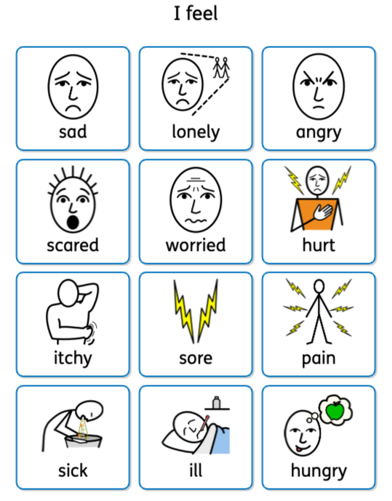

Slide 7
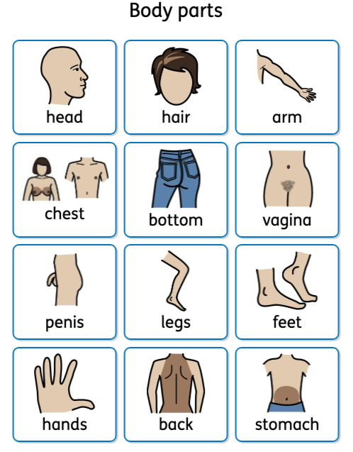

Slide 8
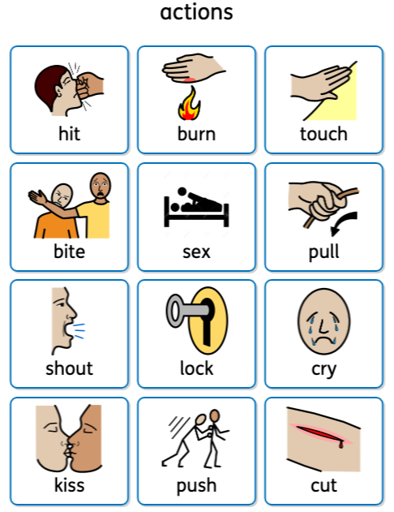

Slide 9
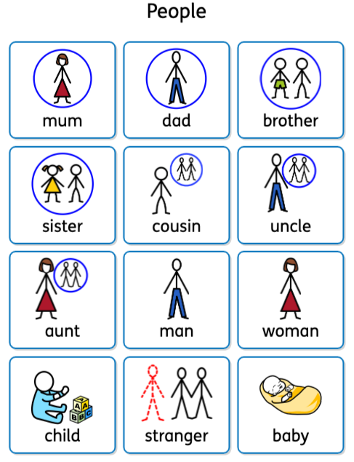

Slide 10
